Slide 1

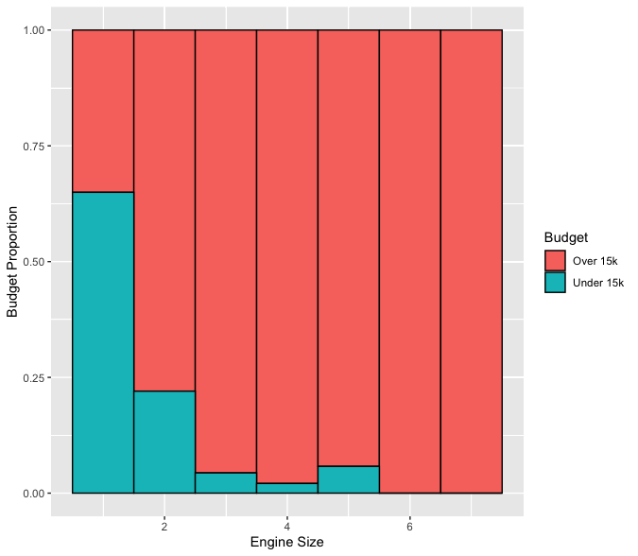
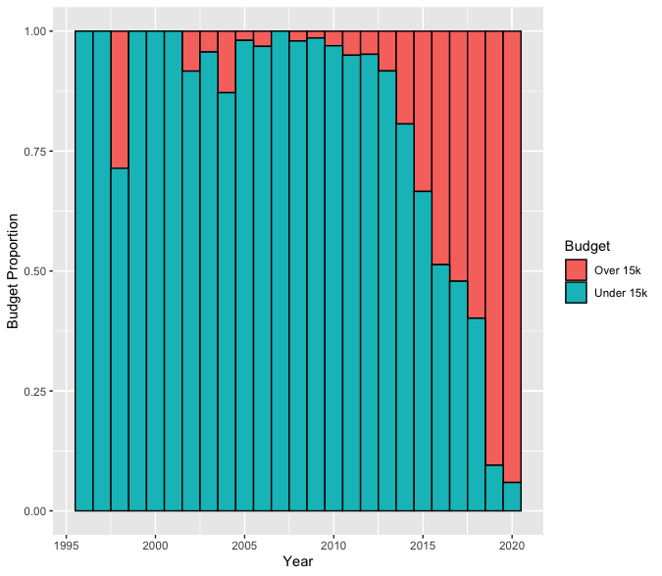
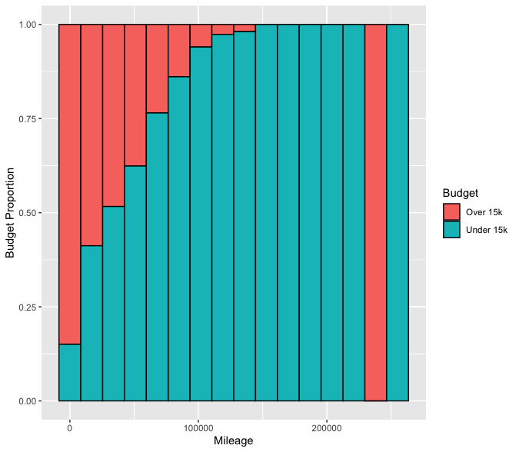
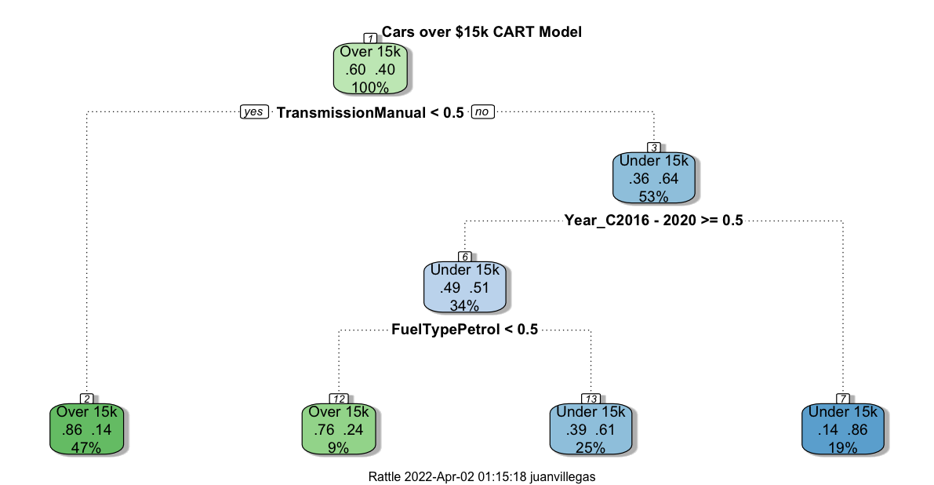
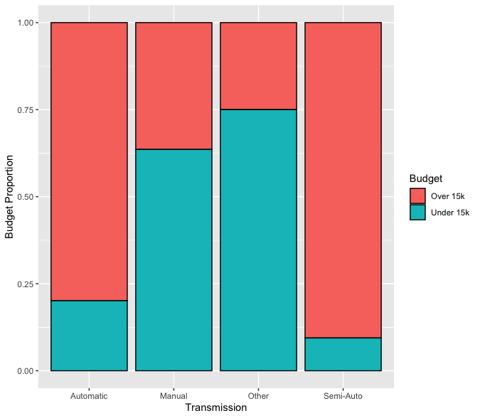
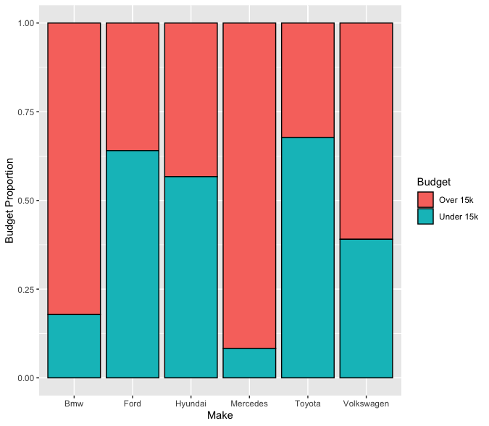
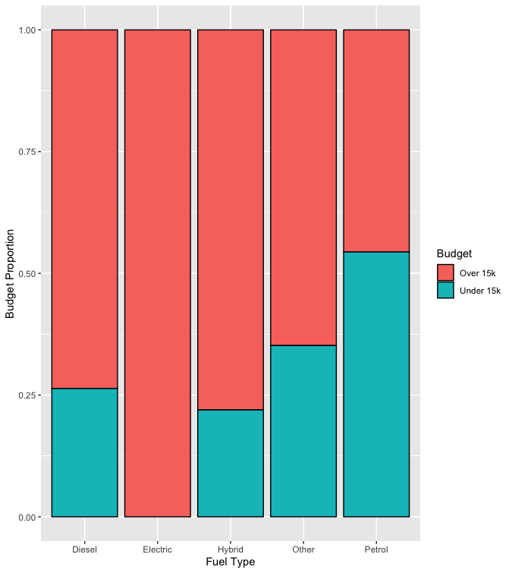
Buying A Used Car In A Bull's market: Can Data Science Help? Juan Villegas
ABSTRACT On July of 2020, my father helped me buy a 2011 Subaru Impreza with 64k miles for $6k. On December 6th, 2021, I got in a car accident where my insurance deemed my car a total loss. My Impreza had 87k miles (23k more miles) & I received $7.2k from my insurance ($1.2k more than what I paid for it). To give you a look at the current used car market: If I was to buy the same Impreza, I bought 2 years ago with the same mileage, it would cost me $8.8-$11.5k (that’s a 46%-91% price increase).
Now that I’m carless again, I decided that this time, I would look for a car myself. Not knowing anything about cars, I decided data science would be useful tool. Having a budget of 15k, data science is going to help tailor my search.
EXPLORATORY DATA ANALYSIS
Model & Results
Figure 1: Engine Size with budget overlay
Figure 2: Year with budget overlay
Figure 3: Mileage with budget overlay
METHODOLOGY To obtain our results, 10-fold cross validation was used on CART decision tree models.
This CART model results in 3 terminal nodes classifying 59% of our data into the “Over $15K” category and 41% into the “Under $15K” category.
Figure 4: Transmission with budget overlay
Figure 5: Make with budget overlay
Figure 6: Fuel Type with budget overlay
The best way to find a car for less than $15k is to look for a car that has a manual Transmission and was made before 2016. If you're looking for a car made after 2016, make sure it runs on Petrol.
INTRODUCTION Using Kaggle I acquired a dataset called ‘100k UK Used Car Data set’ to conduct this analysis. From this data set, I focused on 6 variables: Engine Size, Year, Mileage, Transmission, Make, and Fuel Type. .
CONCLUSION
Our model shows the most strength when it identifies cars that cost more than our budget of $15,000. It correctly Identifies these cars 83.44% of the time. Additionally, this model has a high specificity of 83% when identifying cars over $15,000. This is useful to know because when deciding to buy a car, I want accurate information on what makes a car expensive so I can avoid these things. This saves me time by giving me a narrow list of attributes to look for in cars.
The Overall accuracy of our entire model is 80%, which is good considering that 60% of the cars in this entire data set are over our budget.
It is apparent that 2 attributes that impact a cars high price is: The type of Transmission and the Year. This is going to reduce the number of cars I look for when I search for a used car!
Figure 1 shows that as engine size increases, the cost of a car increases as well.
Figure 2 shows that newer cars are more likely to cost more than $15K. 90% of cars built in 2019-20 cost more than $15k.
Figure 3 shows that as the mileage of a car increases, it is more likely to cost less than $15k.
Figure 4 Shows that Semi-Auto & Automatic cars are more expensive than Manual or *Other (Other refers to Continuously variable transmission (CVT)) vehicles.
Figure 5 shows that Toyota, Fords & Mercedes are the brands with the highest proportion of cars costing less than $15K. They all have a proportion higher than .58.
Figure 6 shows that most the Fuel Type associated most with car costing less is Petrol. All Electric Vehicles are more than $15k.
REFERENCES “2011 Subaru Impreza Values & Cars For Sale | Kelley Blue Book. https://www.kbb.com/subaru/impreza/2011/.
Aditya. “100,000 UK Used Car Data Set.” Kaggle, 4 July 2020, https://www.kaggle.com/adityadesai13/used-car-dataset-ford-and-mercedes.

